Slide 1

Introduction to Data Science
Notes:
Today’s session will be an easy introductory session to data science.

Slide 2
House keeping
Make sure you are comfortable
Have water and maybe a strong coffee handy
If you need a break...take it - We’ll aim for a 5min break every 1 hour
If you need a stretch - please go ahead!
Please mute yourselves if you are not talking
Notes:
Make sure you are comfortable
Have water and maybe a strong coffee handy
If you need a break...take it but We’ll aim for a 5min break every 1 hour
If you need a stretch - please go ahead!
Please mute yourselves if you are not talking

Slide 3
Learning Objectives
Understand what data science is and who a data scientist is.
Understand the differences between classical programming and machine learning
Discuss the types of machine learning and their use case
Familiarise yourself with machine learning terms and definitions.
Notes:
Understand what data science is and who a data scientist is.
Understand the differences between classical programming and machine learning
Discuss the types of machine learning and their use case
Familiarise yourself with machine learning terms and definitions.

Slide 4
What is Data Science?
Notes:
Part 1 – Data Science

Slide 5
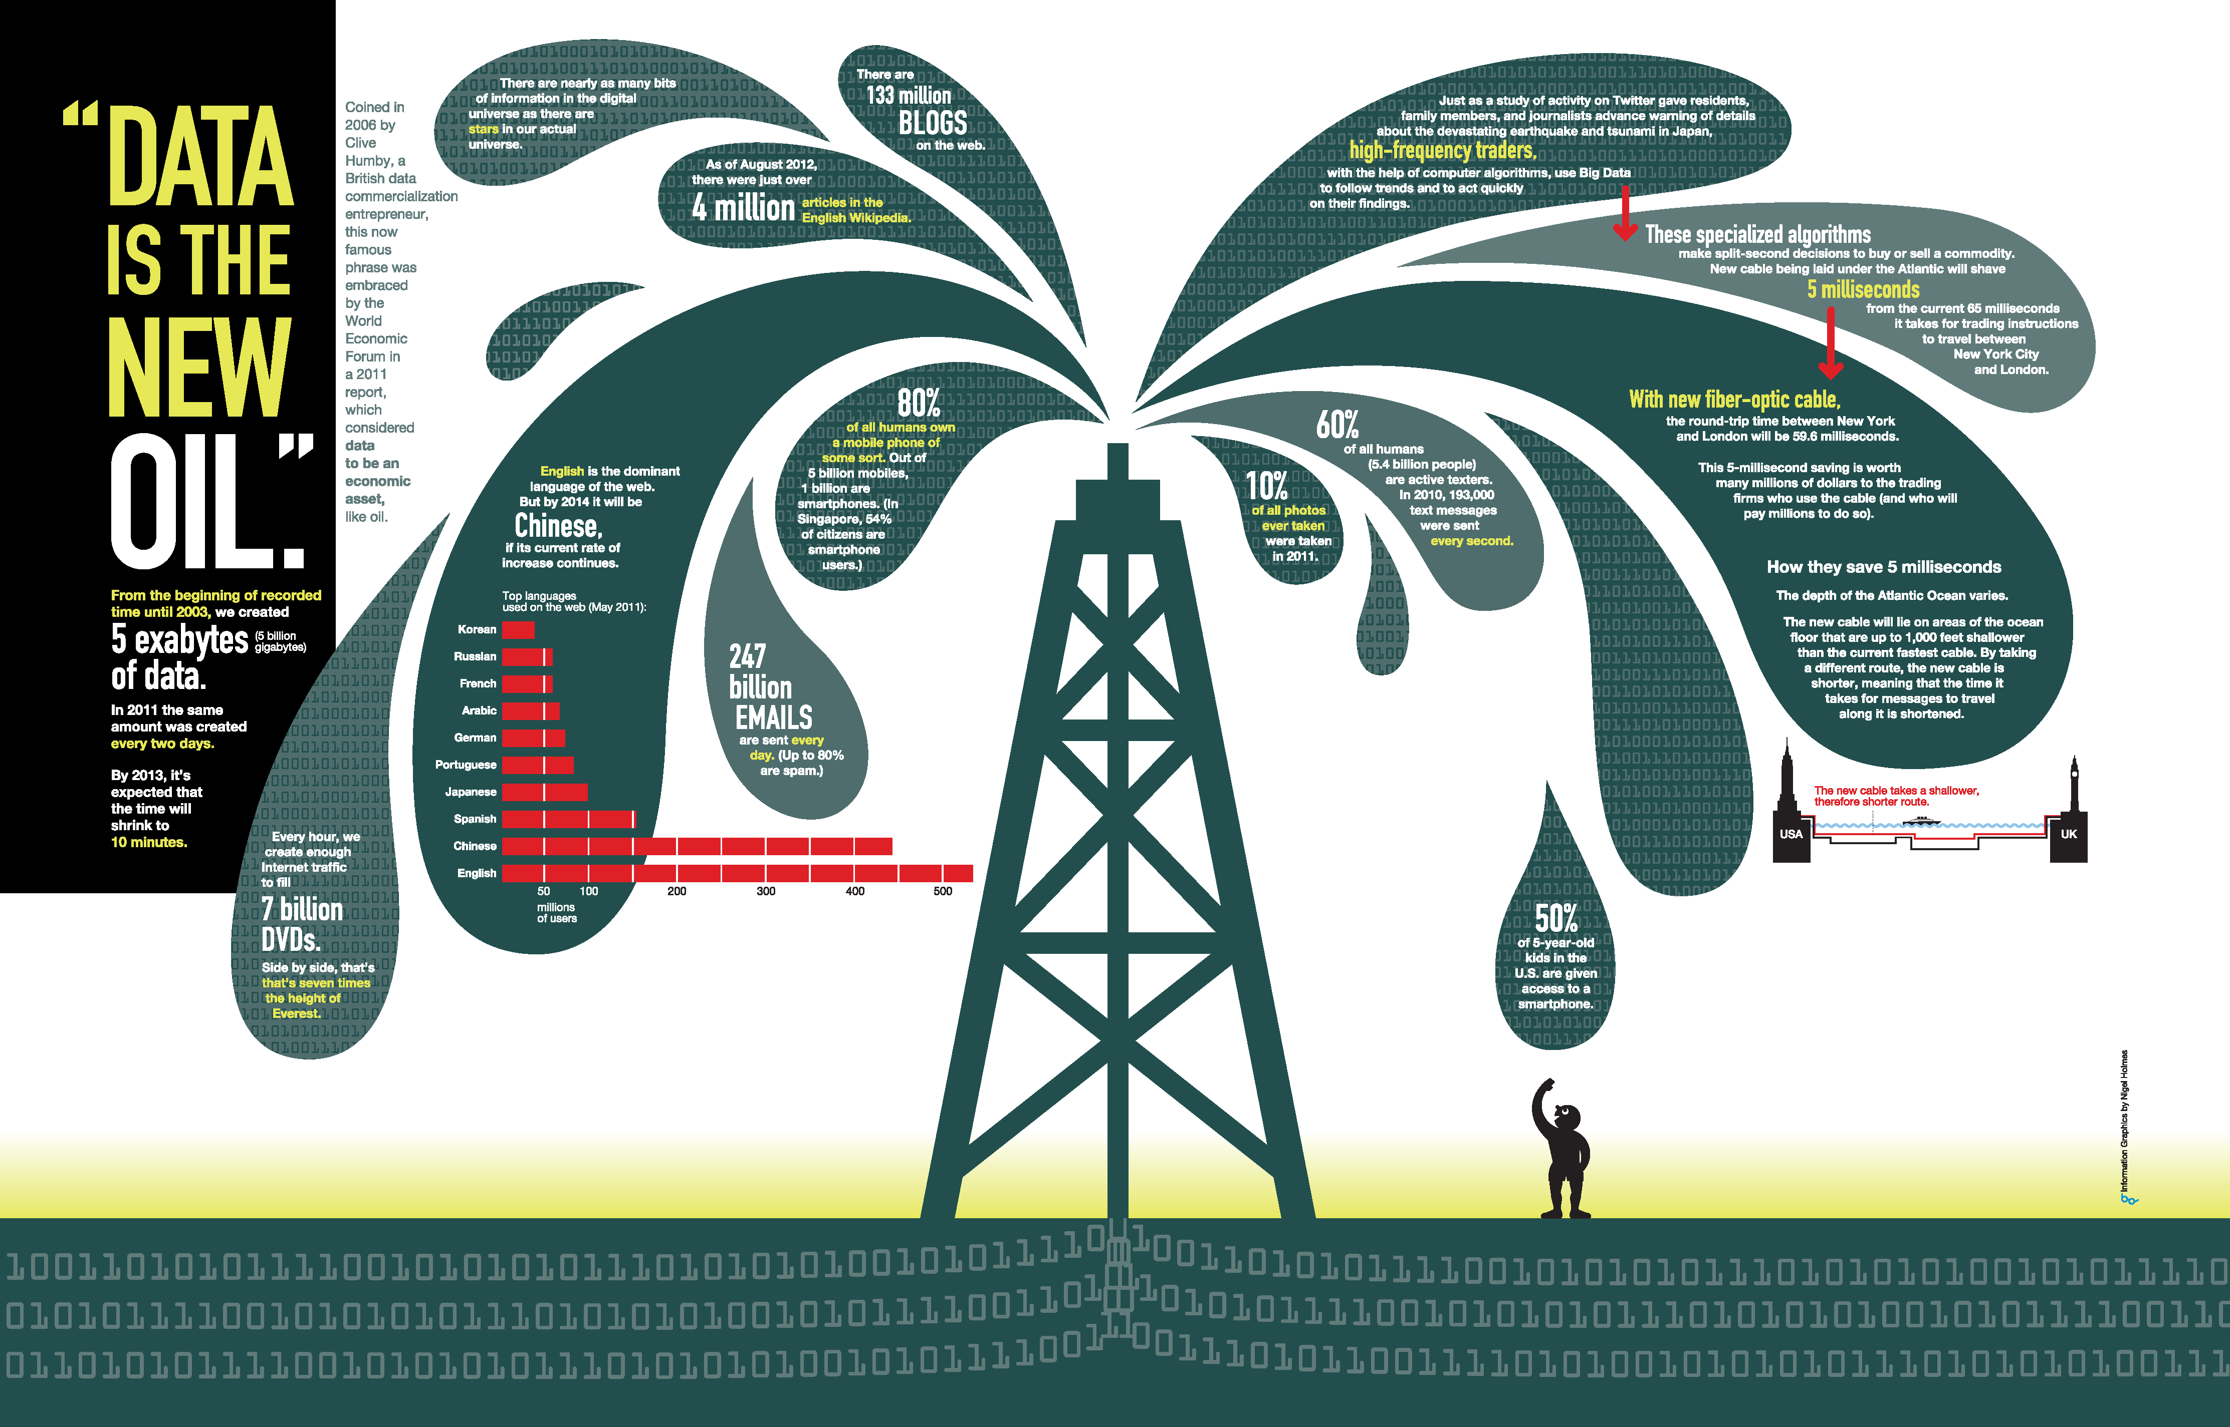
Notes:
“Data is the new oil.”
Has any of you heard this phrase before?
This phrase was coined in 2006 by Clive Huby, a British data commercialization entrepreneur,
in other words it states that
Data is just like crude oil. It’s valuable, but if unrefined it cannot really be used.
It has to be changed into gas, plastic, chemicals, etc to create a valuable entity that drives profitable activity;
so data must be broken down and analyzed for it to have any value.
To give you abit of context of the exponential data increase –
The same amount of data that was generated every 2 days in 2011, it is now generated in every 10 minutes
This is immense!

Slide 6

What is data science?
Notes:
So what is the science of data?
Data science lies at the intersection of business knowledge, statistical analysis, and computer science.
Data science (DS) is a multidisciplinary field of study with a goal to address the challenges in data
A skilful data scientist uses their business knowledge to understand a problem,
applies statistical techniques to collect data and model solutions,
and writes programs to run their analysis and generate results.
To be successful in this field you will need to be able to demonstrate all 3.
Remember that this won’t happen overnight and that it will take practise and dedication.

Slide 7
What is the goal of
data science?
Turn data into data products*.
* According to the McKinsey Global InstituteData, data is a $300 billion-a-year industry
Notes:
The goal of datascience can be summarized in a sentence.
Turn data into data products. data product is something that you sell which is purely (or derived from pure) data
And according to McKinsey global insititute data, data is a 300 Billion a year industry.
What are some examples of data products?
Amazon product recommendations, Netflix movie suggestions, Targeted marketing, Loyalty programmes,
APIs published by Twitter, LinkedIn, Facebook etc, Web Scrapings

Slide 8
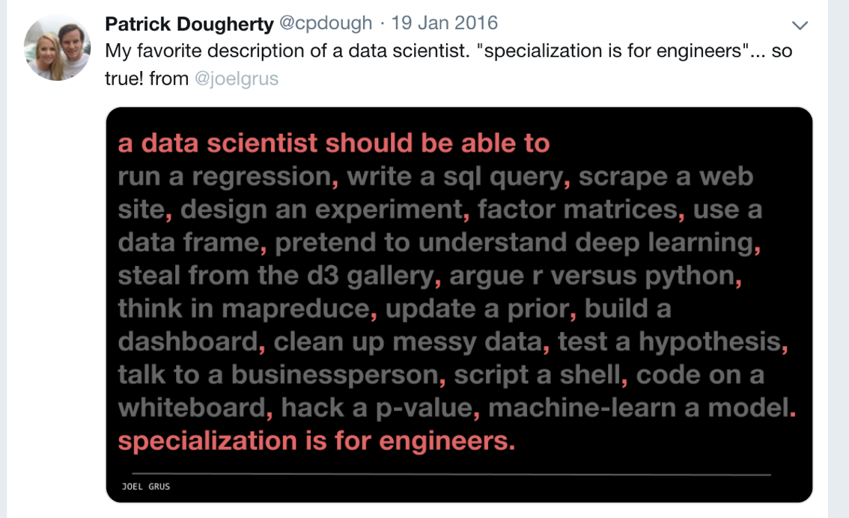
Who is a Data Scientist?
Notes:
So who is a data scientist?
This tweet is one of my favourite descriptions of what makes a data scientist.
Data scientists are the key to realizing the opportunities presented by data.
They bring structure to it, find compelling patterns in it, and advise executives on the implications for products, processes, and decisions
Take a moment to read the tweet and send in your response in the chat.
Sql,dataframe use, dashboard, clean up messy data, test a hypothesis, talk to business person

Slide 9
Types of data science work
Data science tends to fall into three broad categories:
Investigating – aggregating and inspecting data to get basic insights on what is currently happening
Predicting – taking the data and using it to understand what will happen in the future
Optimizing – using the data to choose what the best choice of actions will be
Simple
Complex
© Dr. Jonathan D. Adler
Notes:
Data science projects tend to fall into 3 broad categories.
Investigating – whereby we aggregate and inspect data to extract insights on what is happening
Perdicting – whereby we take data and use them to make predictions
And Optimizing – where we use the data to choose the best course of action for a scenario.
The complexity increases as we move from investigating to optimizing.
Let’s now look at. Bit more detail what each types entails.

Slide 10
Investigating
Look at historic data to answer direct questions:
If you have two products, which is selling better? How many people are buying both?
How frequently do customers order?
How are sales changing each month?
These questions are generally quick to answer and don’t require a mathematical model
Difficulty is in knowing which measures to use and how to visualize/represent them
© Dr. Jonathan D. Adler
Notes:
Investigating seeks to use historic data to answer questions like:
If you have two products, which one is selling better? How many people are buying both?
How frequently do customers order?
How are sales changing each month?
These questions are generally quick to answer and don’t require a mathematical model
The difficulty is in knowing which measures to use and how to visualize or represent them

Slide 11
Predicting
Look at historic data to predict:
How likely is a customer going to come back?
How will a customer respond to a sale?
Is revenue going to increase over time?
Requires mathematical modeling: regressions, clustering algorithms, etc.
Sometimes the data isn’t there to make the prediction, sometimes the prediction is wrong, or requires more skill to do well
© Dr. Jonathan D. Adler
Notes:
Predicting looks at historic data to answer questions like:
How likely is a customer going to come back?
How will a customer respond to a sale?
Is revenue going to increase over time?
Unlike investigating, predicting requires mathematical modeling to produce predictions.

Slide 12
Optimizing
Look at the historic data to make the best decisions
How much inventory should be held, and when should you reorder?
Which product should you recommend to a website visitor for the most profit?
What price should you set for a product? When should it go on sale?
These problems are the hardest to get right
They also directly provide the most profit
© Dr. Jonathan D. Adler
Notes:
Optimising looks at historic data to help you make the best possible decisions.
It answers questions like:
How much inventory should be held, and when should you reorder?
Which product should you recommend to a website visitor for the most profit?
What price should you set for a product? When should it go on sale?
Optimising is the most difficult type of data science projects but at the same time it is the most rewarding in terms of insights and profit.

Slide 13
Data Science in the Real World
Describe a product or a service from your everyday life you think utilizes data science.
Room with the most examples wins
Notes:
We are now going into break out rooms.
And I’ll give you 5 minutes to write down as many examples of data science from your everyday life, you can think of.
The room with the most examples wins the round.

Slide 14
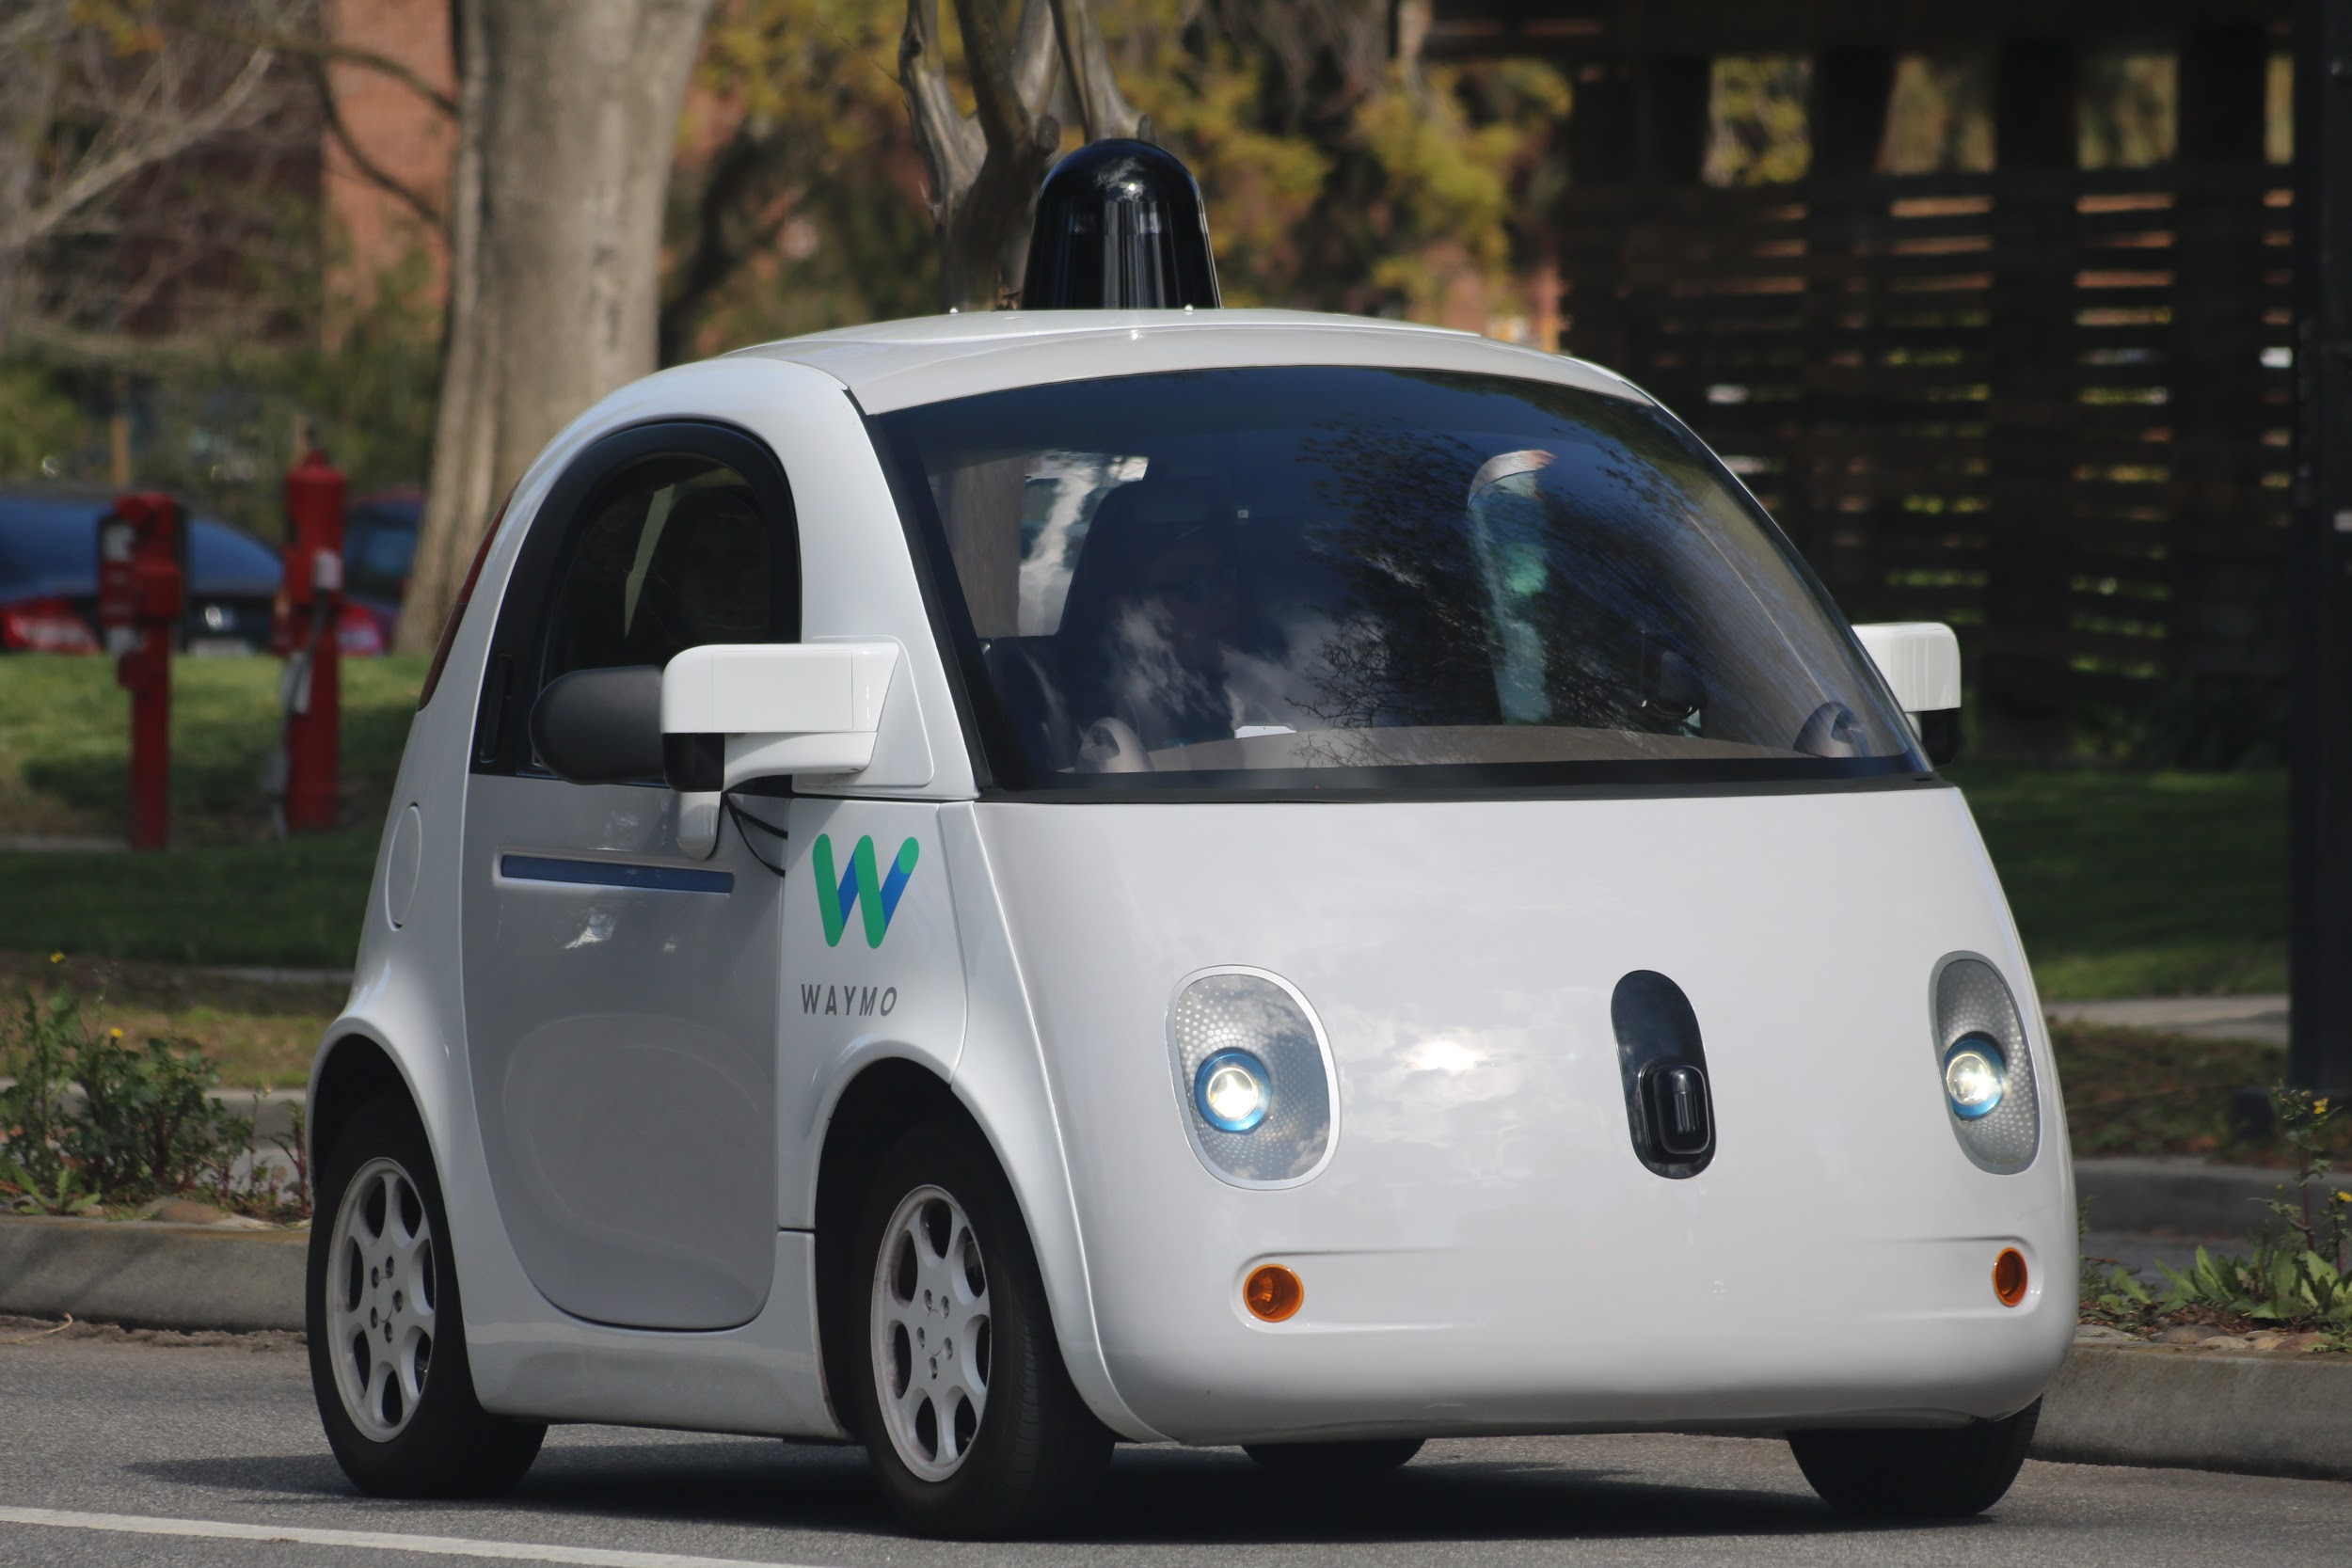

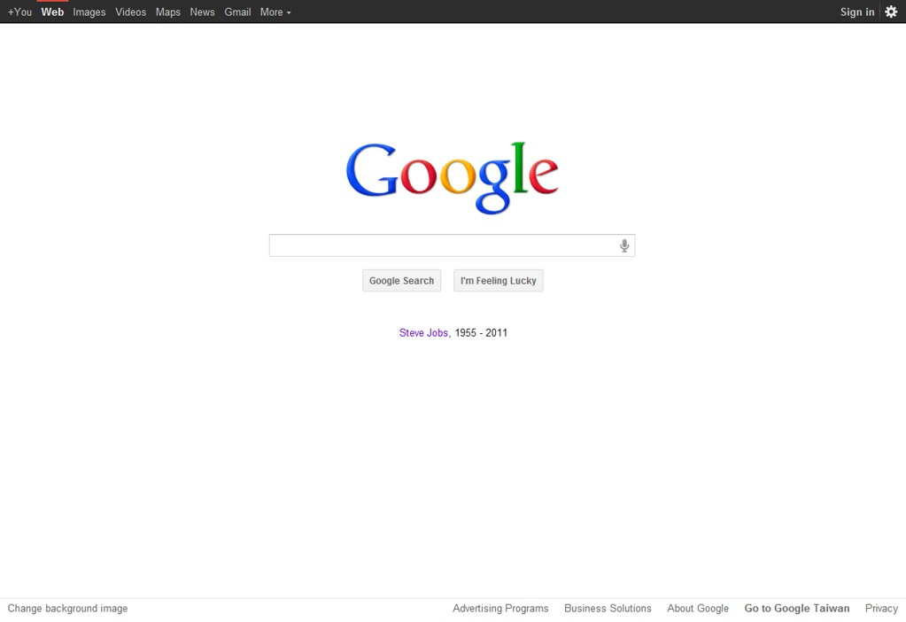


Intro to Data Science
How can companies learn your secrets. Link
Notes:
Here’s some examples:
Providing movie recommendations on Netflix based on your watch history.
Making product suggestions on Amazon.
Developing self-driving cars
Returning auto-translate and search results on Google
Smart Thermostats like Hive where you can control heating in your house with your smartphone.
There’s many many more examples and sometimes we take them for granted
But 10 years ago all these we see and experience weren’t there
I am personally very curious to see what the next 10 years would look like.

Slide 15
Data Science Workflow
Notes:
Let’s now revisit something from our recent past.

Slide 16
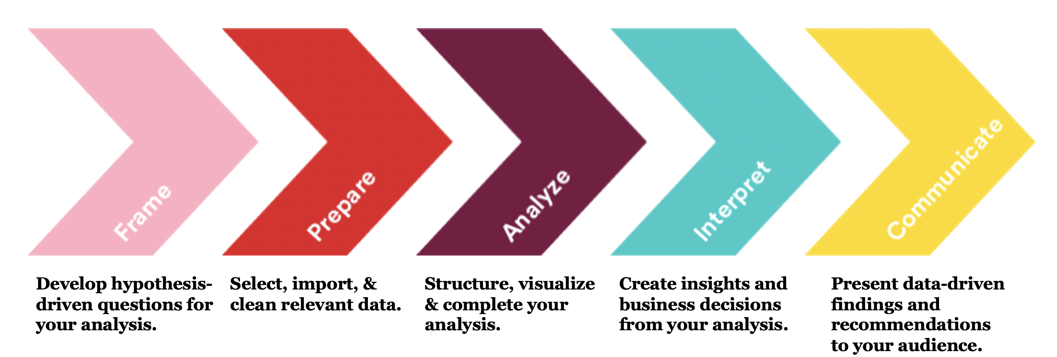
Notes:
The data analytics workflow. It’s an old familiar friend and acts as a reminder
for the essential steps that we take for data science initiatives.
Take a moment to remind yourselves of these steps and then we’ll carry out an activity.
Remember, these steps are not hard-set rules; instead, think of them as problem-solving guidelines.
Some projects may not require every step.
These steps are iterative; it's normal to go back and repeat certain steps a few times in a row.
The process is cyclical; after completing the process, you may restart it.
Let’s now put this diagram into use for a business case scenario.

Slide 17

Activity
Business Scenario
You work for a real estate company interested in using data science to determine the best properties to buy and resell. Specifically, your company would like to identify the characteristics of residential houses that estimate their sale price and the cost-effectiveness of doing renovations.
Using the workflow, describe some of the activities that you would carry out in each stage.
10 minutes
Notes:
You work for a real estate company interested in using data science to determine the best properties to buy and resell.
Specifically, your company would like to identify the characteristics of residential houses that estimate their sale price
and the cost-effectiveness of doing renovations.
You Will go into BOR and I'll give you 10 minutes to use the workflow we presented in the previous slide to solve the problem..
After we come back i’ll give 5 minutes for each group to go through what they have come up with.

Slide 18
Frame
Identify the business/product objectives.
Identify and hypothesize goals and criteria for success.
Create a set of questions to help you identify the correct data set.
Analyze
Summary/Descriptive statistics
Identify preliminary trends
Exploratory data analysis
Create a predictive model
Communicate
Stakeholder presentations
Reports
Take feedback on board and reiterate your work
Prepare
Ensuring data is clearly defined and structured
Check and clean data formatting as needed
Create data dictionaries and source documentation to determine how the set was gathered
Interpret
Did you reject or fail to reject your hypotheses?
Were your questions answered?
Do your findings support any business recommendations, actions, or decisions?
Reaching a conclusion
Notes:
Here’s some ideas on what goes on at each stage.
For the framing stage, we seek to:
Identify the business objectives –what kind of properties to buy
Create a hypothesis and define what success would look like
Formulate a set of questions to help you identify the correct data set.
For the preparing stage, we seek to:
Ensure data is clearly defined and structured
Check and clean data formatting
Create data dictionaries and source documentation to determine how the data was collected
For the analyze stage, we seek to:
Perform summary statistics
Identify preliminary trends by exploratory data analysis
Ideally create a predictive model
Next we interpret our findings
Do we accept or reject our hypothesis
Are all our questions answered
What are our recommendations to the business or client?
We have to reach a conclusion at this stage
Finally we communicate our conclusions Through
Stakeholder presentations and reports
We take feedback and repeat or improve any steps as we see fit.

Slide 19
Introduction to Machine Learning (ML)
Common Terms and Definitions
Notes:
Do not panic by the title here.
There is no maths or scary equations involved.

Slide 20
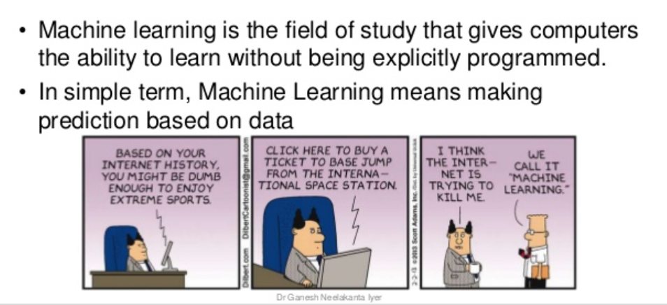
Machine Learning
Notes:
Machine learning is the science behind computers learning to perform a task without us humans programming them explicitly.
Machine-learning algorithms use statistics to find patterns in massive* amounts of data.
And data, here, encompasses a lot of things—numbers, words, images, clicks, etc.
If it can be digitally stored, it can be fed into a machine-learning algorithm.
Frankly, this process is quite basic: find the pattern in data, apply that pattern to new data. But it pretty much runs the world.
https://www.slideshare.net/ganeshn9/machine-learning-and-its-applications-138639251

Slide 21
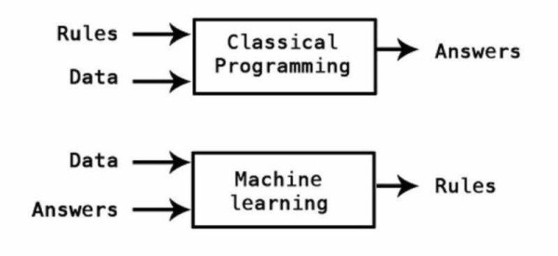
ML vs Programming
Notes:
In your prework you started learning programming. But how does programming differs from ML?
Can someone guess what is the difference between programming and machine learning?
What do you need as input in classical programming and what do you need as input in ML?
Here’s a hint:
In classical programming, we provide the Rules and the data. The computer then finds the answers from the rules and data.
In Machine learning, we supply the data and the answers, the computer learns the relationship and generates the rules governing a situation.

Slide 22
Programming
Data:
[3, 4, 5]
Rules:
Multiply data by 5
Add 7
Answers:
[22, 27, 32]
Notes:
Let’s look at some practical examples.
Classical programming is rule based. For example:
The rules are:
Multiply data by 5 and add 7
Your data is:
[3,4,5]
The output based on the rules and data would be: [22, 27, 32].

Slide 23
Machine Learning
Data:
[3, 4, 5]
Answers
[22, 27, 32]
Rules:
Data * 5 + 7
Notes:
In contrast, for machine learning we’ve got the answers and the data and we have to identify what the rules are, based on those answers and data.

Slide 24
https://www.youtube.com/watch?v=KNAWp2S3w94
Notes:
https://codelabs.developers.google.com/codelabs/tensorflow-lab1-helloworld/#1

Slide 25
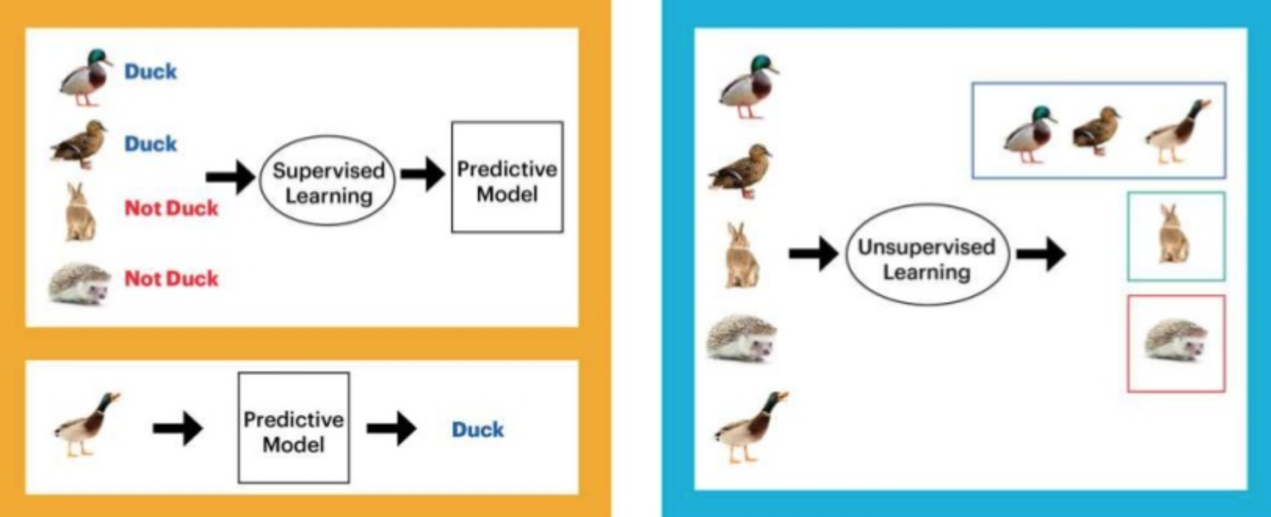
Categories of ML
Supervised Learning
Unsupervised Learning
Notes:
Two of the main ML categories are supervised and unsupervised learning.
Take a moment and look at this figure. Then i want someone to try and interpret what supervised and unsupervised learning does.
highlight the presence of labels in SL
Answers:
Supervised learning predicts an outcome based on input data.
Unsupervised learning Extracts structure from data.

Slide 26
Supervised Learning
We teach a model using labelled data.
Also known as predictive modelling.
Notes:
IN SL:
First, we train a model using labelled data .
The “machine learning model” learns some kind of relationship between the labelled data and the response.
Then, we make predictions on new data for which the response is unknown.
It requires past data to perform any predictions.

Slide 27
Types of Supervised ML
Regression: The outcome to predict is a continuous value.
Classification: The outcome we are trying to predict is categorical.
Notes:
The main categories of supervised ML is regression and classification.
In both regression and classification, the goal is to find specific relationships or structure in the input data that allow us to effectively make a prediction.
The regression predicts an outcome that is a continuous variable and the classification predicts an outcome that is a categorical variable.
What is the difference between a continuous value and a discrete value?
Ask the apprentice to think of an example of a regression ML
Ask the apprentice to think of an example of a classification ML
Give examples in each case
Examples of regression include predicting price of stocks given some parameters, predicting the blood pressure of a patient, temperature given weather conditions, etc.
Examples of classification include email classification as spam/not spam, etc.
Categorical - Contains a finite number of categories or groups. For example payment method (e.g. cash, credit card, debit card, etc).
Continuous - Numeric variables that have an infinite number of values between any two values. For example, the length of a carpet. Or you can have one meter and two centimeters of tape.
https://aldro61.github.io/microbiome-summer-school-2017/sections/basics/

Slide 28
Unsupervised Learning
The model is provided with unlabelled data and learns to identify the underlying structure in data
Notes:
Unsupervised learning Extracts structure from data.
we wish to learn the inherent structure of our data without providing the computer any labels
For Example: Unsupervised ML can help marketeers discover distinct groups in their customer base.
They can then characterize their customer groups based on the purchasing patterns.
For example in Harrods, there are different tiers of customer groups.
If you spend more than £10K/year you are a Black member and you get different perks than the other customer groups.
One basic difference is that the unsupervised learning approach does not require past data to give an output.

Slide 29
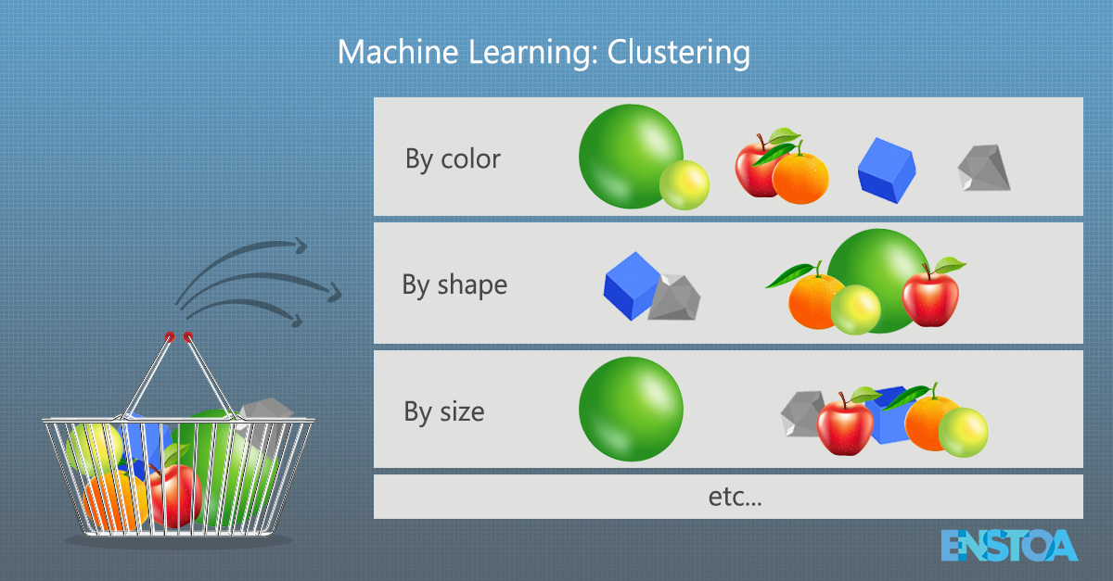
Common uses of Unsupervised ML
Clustering: Grouping similar data points together.
Notes:
Clustering is perhaps the most common algorithm used in unsupervised learning.
Clustering - is about grouping similar data points together. For example:
Imagine you have some fruits in a basket. Each item has a distinct set of features (size, shape, color, etc.).
Imagine now that you have been tasked with grouping each of the objects in the basket. A natural question is, ‘on what basis will I group these objects?’
Perhaps size, shape, or color. Or perhaps not.
The answer you choose may depend on many factors, including how many objects there are, how similar (or different) they are, or even how heavy certain objects are. It isn’t at all obvious which grouping criterion you should choose.
– Clustering can be Useful when don’t know what you’re looking for in your data and you wish to identify an underlying structure.

Slide 30
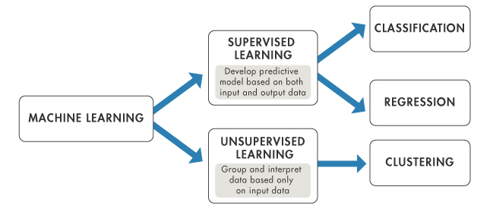
In summary
Notes:
Here’s a quick summary. In ML we’ve got Supervised and Unsupervised learning.
In supervised learning we develop a predictive model based on both input and output data
while in unsupervised learning we group and interpret data based on input data only.
Two common algorithms of SupLearn are classification and regression.
While Clustering is a common UnsupLearn alogirthm.

Slide 31
Activity
Notes:
Let’s do an activity now

Slide 32
Activity
In the folder there is a dataset called “ames.csv” and a file called “description.txt”
What is a potential target in your data for a regression model?
What is a potential target in your data for a classification model?
Pick one of your targets and sketch out what a data science workflow would look like for that question.
Frame: Develop a hypothesis-driven approach to your analysis.
Prepare: Select, import, explore, and clean your data.
Analyze: Structure, visualize, and complete your analysis.
Interpret: Derive recommendations and business decisions from your data.
Communicate: Present (edited) insights from your data to different audiences.
20 minutes
Notes:
Ames.csv gives information on housing properties.
What is a potential target in your data for a regression model? Look for continuous var: e.g. lot area /saleprice
What is a potential target in your data for a classification model? Look for discrete var: any (condition)
Year remodel and overall condition
--------------------------------------------------------------------
UL: group and interpret data based on input data
OverallQual: Rates the overall material and finish of the house
RoofMatl: Roof material
Example of clustering:
identify different market segments in your data.
Maybe you’d find out that home buyers in the neighborhood near the local college really like small houses with lots of bedrooms, but home buyers in the suburbs prefer 3-bedroom houses with lots of square footage. Knowing about these different kinds of customers could help direct your marketing efforts.
https://medium.com/@ageitgey/machine-learning-is-fun-80ea3ec3c471

Slide 33
Activity

Slide 34
Activity
In breakout rooms, think about a use case (if any) or potential use case of ML in your organization
What type of ML would it be (supervised or unsupervised). If supervised, is it going to be regression or classification.
What benefits does your organization gets with potential implementation of ML
Present your answer
10 minutes
Notes:
10 minutes

Slide 35
Algorithms
Notes:
Regardless of whether it's supervised or unsupervised, the underlying engine driving a machine learning model is an algorithm.
These algorithms are used to help identify trends, represent said trends, and explain the overall variance of the data.

Slide 36
Algorithms
“An algorithm is a sequence of steps (rules) to solve a problem. Must be finite and solves the problem”
Notes:
The engine of any machine learning model
“An algorithm is a sequence of steps (rules) to solve a problem. Must be finite and solves the problem”
Algorithms allow us to solve problems by following sequence of steps to reach the solution.
It is the way computers are able to solve problems. When we write rules for a computer to solve problems, we are writing algorithms.

Slide 37


Algorithm
Algorithm:
Multiply data by 5
Add 7
Equation:
Answer = 5 * data + 7
y = mx + b
Notes:
Let’s think of a very basic algo that takes the data, multiplies them by 5 and adds 7.
This is translated into a simple straight line equation.
But if you just throw that equation into the computer, it throws an error because it is not written algorithmically.
To make the computer solve problems using that equation, we need to write the rules on the left in a language that the computer understands.
In other words, by understanding algorithms you will be able to explain to the computer the series of steps you want it to follow in order to solve a problem.

Slide 38
Activity

Slide 39
Activity
Let's say we are a real estate agent looking to price a house using only its square footage. We know there are other features that can highly influence this outcome, but we are only focusing on square footage for now. We know that, as square footage increases, so does price.
Recently, we sold a house whose square footage was 2,500 for about £285,000 and added an additional £10,000 for stamp duties. Based on this information:
Generate an equation for house price using the square footage and stamp duties
Generate an algorithm for a computer to compute price of a house given this information
10 minutes
Notes:
Answer:
Price = 114*sq_footage + 10000
285000/2500 =114
Y=mx+C

Slide 40
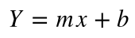
Solution
From the information given we work out that this is a linear model. I.e. the dependent variable (price) increases as the independent variable (sq. footage) increases.
The general equation for a linear models is:
We know that stamp duty is paid for each sale. That is a constant value. Hence b=10000.
We also know that a 2500 sq. footage property was sold for 285000. What is the constant of proportionality in this case? 285000/2500 = 114. Hence m=114.
Hence our model (i.e. equation) would be:
Price = 114*sq_footage + 10000
Notes:
This is an example of a model built with the intent of predicting price. The algorithm is simple and built off of limited information. Typically, our models will be more complex, and we'll consider a greater amount of prior data before developing a final algorithm.
From the information given, we work out that this is a linear model. I.e. the dependent variable (price) increases as the independent variable (sq. footage) increases.
The general equation for a linear models is: y=mx+c
We know that stamp duty is paid for each sale. That is a constant value is added on top of evert sale. Hence b=10000.
We also know that a 2500 sq. footage property was sold for 285000. What is the constant of proportionality in this case? 285000/2500 = 114. Hence m=114.
Hence our model (ie. equation) would be: Price = 114*sq_footage + 10000

Slide 42
Definitions
Model building would be the task of constructing an actual algorithm.
This is the linear model of
Training involves figuring out the coefficient and the Y intercept the model uses for our intended purpose.
The coefficients uncovered via training were b=10000 and m=114
Notes:
Here’s two definitions we’ll be coming across often when we do ML
Model building would be the task of constructing an actual algorithm.
This is the linear model of y=mx+c
Training involves figuring out the coefficient and the Y intercept the model uses for our intended purpose.
The coefficients uncovered via training were b=10000 and m=114
In real business case scenarios we will have to feed our model with loads of values of price and square footage size before we can define what values b and m carry.

Slide 43
Questions

Slide 44
Notes:
ML borrows many methods from data science

Slide 45
